Slide 1
Search problems and algorithms
PAL Session Week 3

Slide 2
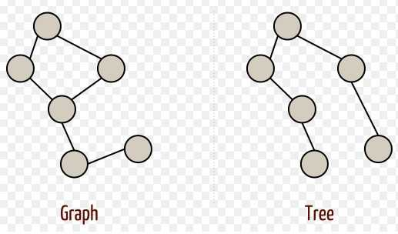
Search algorithms
Search is used when no more direct method is known. Widely used in AI for solving various problems.
For representing search problems:
Initial state
Goal state
State space

Slide 3
Properties of Search Algorithms
Complete: A search algorithm is complete if it ensures a return of solution.
Optimal: It delivers most optimal solutions(best possible solution)
Time Complexity: It is the measure of time taken to complete a task, by a search algorithm as well as the maximum number of nodes created.
Space Complexity: Indicates the maximum storage space required during the search.

Slide 4
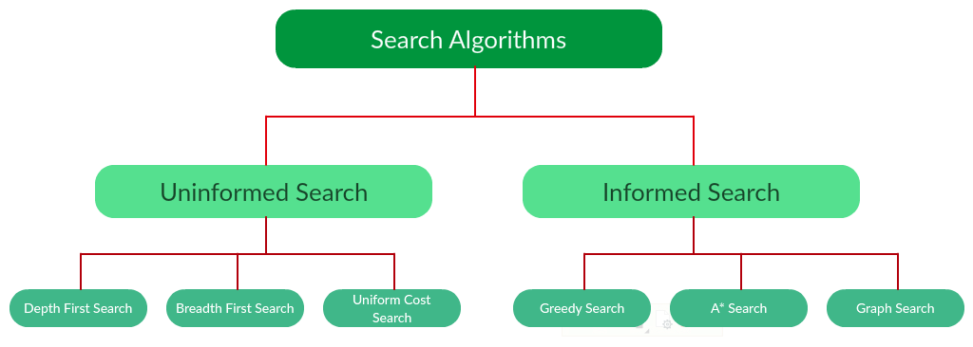
Types of search algorithms
https://www.geeksforgeeks.org/search-algorithms-in-ai/

Slide 5
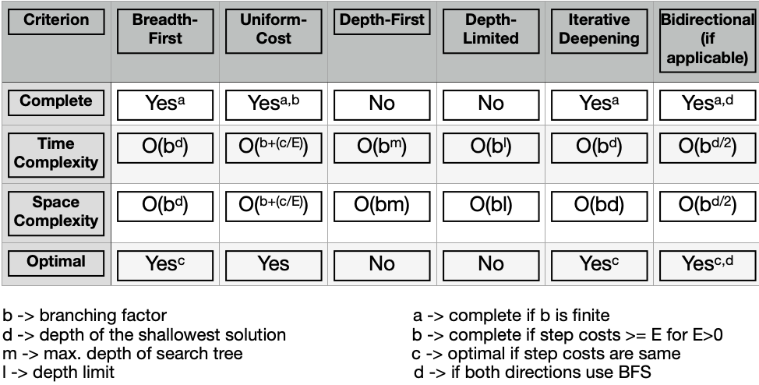
Uninformed search
The algorithm doesn’t use initial information about the search space and the goal’s location. The efficiency of the search can vary depending on the type of problem.
Does not use problem-specific knowledge.
Breadth-First Search
Uniform Cost Search
Depth First Search
Iterative Deepening Search
Bidirectional Search
https://www.analyticsvidhya.com/blog/2021/02/uninformed-search-algorithms-in-ai/

Slide 6
Application and examples

Slide 7
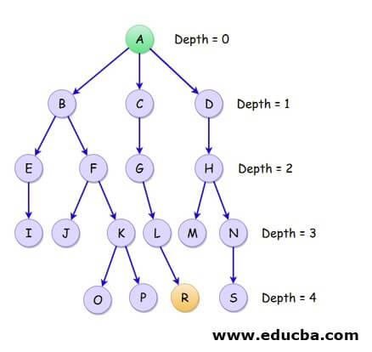
Application and examples
Iterative deepening search- similar to DFS but with a depth bound. Combines ideas from both BFS and DFS
Increase depth with each iteration
Advantage: provides better performance

Slide 8
Informed Searches

Slide 9
What are they?
An informed search will use information about the problem to select the best node to explore.
It chooses the best node based on its value
The node with the smallest value will be selected
But how do we calculate this value?
A heuristic function is often used! → h(n)
h(n) is just an estimate of the cost of the best path from node n to the goal
There is no set heuristic function
We could simply have our heuristic be the Euclidean distance between the current node n and your goal.
So…
f(n) = value of node

Slide 10
Our Example
1
1
1
1
GOAL
1
3
3
1
You want to get to the goal state
Assume that states directly next-to another state has a distance of 1 unit.
Each state shows the cost of moving to it
We can see that two of the states cost 3 times as much as the others
The goal state is called “GOAL”
1
1
1
1
1
1
1
YOU
1
1
1
1

Slide 11
Greedy Best-First Search
1
1
1
1
GOAL
This search only uses h(n) to choose its next node.
Therefore
f(n) = h(n)
1
3
3
1
How would a greedy search look like if carried out on our example?
1
1
1
1
Heuristic: Euclidean distance to goal
1
1
1
YOU
1
1
1
1

Slide 12
Greedy Best-First Search
1
1
1
1
GOAL
This search only uses h(n) to choose its next node.
Therefore
f(n) = h(n)
1
3
3
1
How would a greedy search look like if carried out on our example?
1
1
1
1
YOU
Heuristic: Euclidean distance to goal
1
1
1
1
1
1
1
1

Slide 13
Greedy Best-First Search
1
1
1
1
GOAL
This search only uses h(n) to choose its next node.
Therefore
f(n) = h(n)
1
3
3
1
YOU
How would a greedy search look like if carried out on our example?
1
1
1
1
Heuristic: Euclidean distance to goal
1
1
1
1
1
1
1
1

Slide 14
Greedy Best-First Search
1
1
1
1
GOAL
This search only uses h(n) to choose its next node.
YOU
Therefore
f(n) = h(n)
1
3
3
1
How would a greedy search look like if carried out on our example?
1
1
1
1
Heuristic: Euclidean distance to goal
1
1
1
1
1
1
1
1

Slide 15
Greedy Best-First Search
1
1
1
1
GOAL
This search only uses h(n) to choose its next node.
YOU
Therefore
f(n) = h(n)
1
3
3
1
How would a greedy search look like if carried out on our example?
1
1
1
1
Heuristic: Euclidean distance to goal
1
1
1
1
Reached the goal with a total cost of 5
1
1
1
1

Slide 16
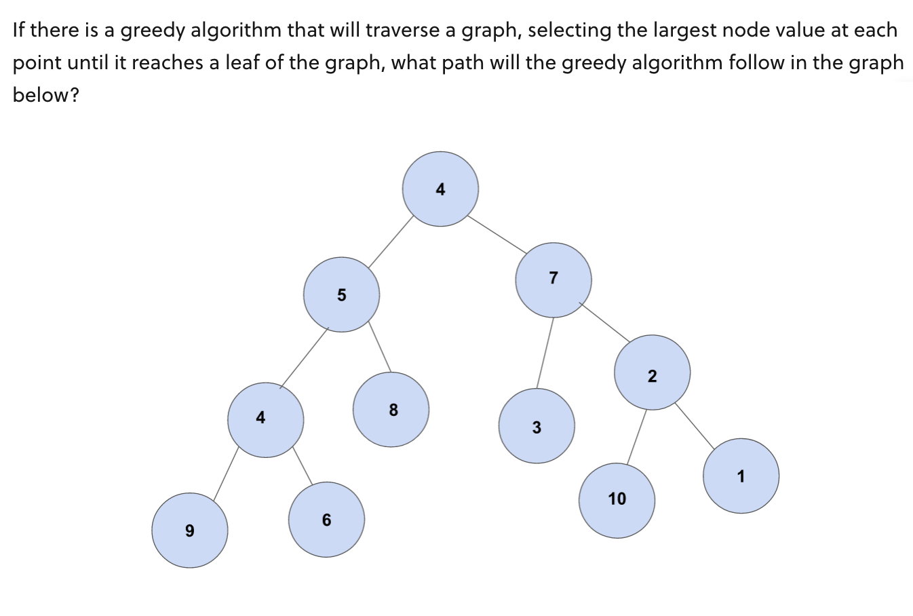

Slide 17
Can we do better?

Slide 18
A* Search
Instead of just using our heuristic function (h(n)) to determine our value for f(n), lets also take into account the cost of getting there.
We can denote this as g(n) → the distance from the initial state to state n
1
1
1
1
GOAL
1
3
3
1
Therefore
f(n) = g(n) + h(n)
1
1
1
1
What would an A* search look like if carried out on our example?
1
1
1
YOU
Heuristic: Euclidean distance to goal
1
1
1
1

Slide 19
A* Search
1
1
1
1
GOAL
How would a greedy search look like if carried out on our example?
1
3
3
1
Heuristic: Euclidean distance to goal
1
1
1
1
1
1
1
YOU
1
1
1
1

Slide 20
A* Search
1
1
1
1
GOAL
How would a greedy search look like if carried out on our example?
1
3
3
1
Heuristic: Euclidean distance to goal
1
1
1
1
YOU
1
1
1
1
1
1
1
1

Slide 21
A* Search
1
1
1
1
GOAL
How would a greedy search look like if carried out on our example?
1
3
3
1
YOU
Heuristic: Euclidean distance to goal
1
1
1
1
h(n) from the node we are currently on
= root 2
= 1.41
1
1
1
1
f(n) = 4 + 1.41 = 5.41
1
1
1
1

Slide 22
A* Search
1
1
1
1
GOAL
How would a greedy search look like if carried out on our example?
1
3
3
1
Heuristic: Euclidean distance to goal
1
1
1
1
h(n) from the node we are currently on
= ((1)² + (2)²)^{1/2}
= root 5
= 2.24
YOU
1
1
1
1
f(n) = 2 + 2.23 = 4.43
1
1
1
1
4.43 < 5.41

Slide 23
A* Search
1
1
1
1
GOAL
How would a greedy search look like if carried out on our example?
1
3
3
1
YOU
Heuristic: Euclidean distance to goal
1
1
1
1
1
1
1
1
1
1
1
1

Slide 24
A* Search
1
1
1
1
GOAL
YOU
How would a greedy search look like if carried out on our example?
1
3
3
1
Heuristic: Euclidean distance to goal
1
1
1
1
1
1
1
1
1
1
1
1

Slide 25
A* Search
1
1
1
1
GOAL
YOU
How would a greedy search look like if carried out on our example?
1
3
3
1
Heuristic: Euclidean distance to goal
1
1
1
1
Reached the goal with a total cost of 4
1
1
1
1
1
1
1
1

Slide 26
Practice Question (5mins)

Slide 27
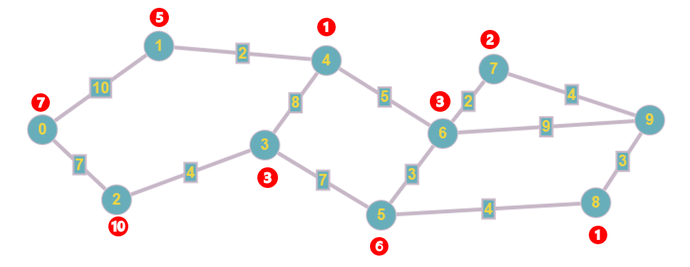

Describe the route the A* Search Algorithm would take to get from nodes 0 – 9. Show how each step is calculated.

Slide 28
Answers
0 – 1: 10 + 4 = 14
0 – 2: 7 + 10 = 17
Choose node 1
1 – 4: 10 + 2 + 1 = 13
Choose node 4
4 – 3: 12 + 8 + 3 = 23
4-6: 12 + 5 + 3 = 20
Choose node 6
6 – 5: 17 + 3 + 6 = 26
6 – 7: 17 + 2 + 2 = 21
6 – 9: 17 + 9 = 26
Choose node 7
7-9 : 19 + 4 = 23
Route Taken: 0,1,4,6,7,9

Slide 29
Admissible
Let h*(n) be the actual cost of the cheapest path from the current state n to a goal state
So…
An admissible heuristic is one which never overestimates the cost to reach a goal.
→ So, h(n) <= h*(n)
i.e. The estimated cost to reach a goal from n <= the actual cost to reach a goal
h(n) = 17
h*(n) = 18
Note: An A* search is optimal if h(n) is admissible

Slide 30
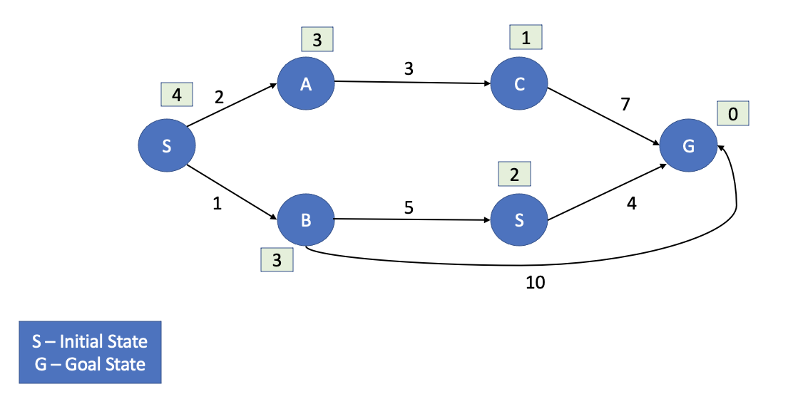
Is the following heuristic admissible?

Slide 31
Is the following heuristic admissible?
YES

Slide 32
Consistent
A heuristic is consistent if, when going from one node to the next, the heuristic does not overestimate the actual step cost.

Slide 33

Is the following heuristic consistent?
3
1
A
3
C
4
2
7
0
S
G
2
1
B
5
S
4
3
10
S – Initial State
G – Goal State

Slide 34
Is the following heuristic consistent?
3
1
NO :(
A
3
C
4
2
7
0
S
G
2
1
B
5
S
4
3
10
S – Initial State
G – Goal State

Slide 35
Discrete Maths
Conjunctive and Disjunctive Normal Form

Slide 36
What are they?
Just a way to represent Boolean Formulas
All Boolean formulas can be represented in both conjunctive normal form and disjunctive normal form
Let’s have a look in more detail

Slide 37
Boolean Formulas
A boolean formula is simply a formula that is made only from boolean literals and logical connectives.
This just means that we have literals {X1, X2, X3, …} as well as
{AND (conjunction), OR (disjunction), NOT (negation), -> (implication)}
Boolean literals: X, NOT X, Y, NOT Z

Slide 38
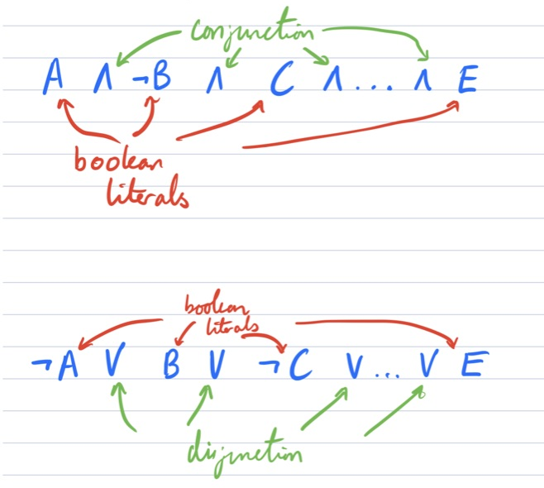
Conjunctive and Disjunctive Clauses
A clause is a list of boolean literals, connected by either conjunction or negation.
Let A, B, C, D, E be boolean variables, then the following:
Conjunctive Clause:
Disjunctive Clause:

Slide 39
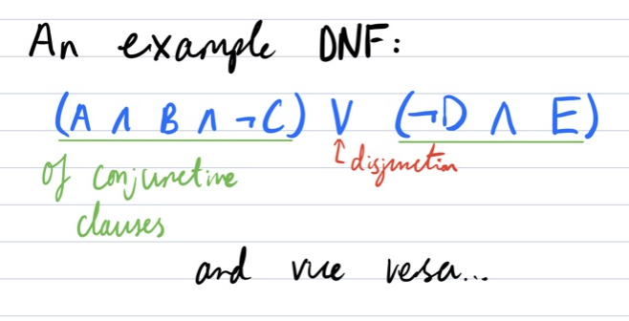
Conjunctive and Disjunctive Normal Form
We can take this a step further and consider what happens if instead of boolean literals, we considered clauses.
This leaves us with conjunctive normal form and disjunctive normal form.

Slide 40
They’re the Same
Theorem:
All boolean formulas can be represented as both a formula in DNF, or formula in CNF.
How do we take any formula there:
Distributive laws
De Morgan’s laws

Slide 41
Kahoot/Questions

